Slide 1

Overview of .net technology

Slide 2
What is .net?
Microsoft .NET (pronounced “dot net”) is a software component that runs on the Windows operating system.
.NET provides tools and libraries that enable developers to create Windows software much faster and easier.
.NET benefits end-users by providing applications of higher capability, quality and security.
The .NET Framework must be installed on a user’s PC to run .NET applications.

Slide 3

What is a framework?
According to dictionary
framework
noun
1. an essential supporting structure of a building, vehicle, or object.
2. a basic structure underlying a system, concept, or text.

Slide 4
Software framework
A software framework is a universal, reusable software platform to develop software applications, products and solutions.
Software frameworks include support programs, compilers, code libraries, tool sets, and application programming interfaces (APIs) that bring together all the different components to enable development of a project or solution.

Slide 5
What is web service?
Web services provide a standard means of interoperating between different software applications, running on a variety of platforms and/or frameworks.
Web Services are units of code that allow programs written in different programming languages and on different platforms to communicate and share data through standard Internet protocols.
Eg: electronic bill payment,stock trading,insurance service etc
What is .net in context of web services?
.net is a software framework that includes everything required for developing software for web service.

Slide 6
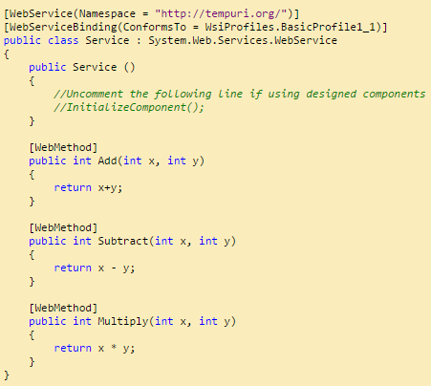
sample web service

Slide 7
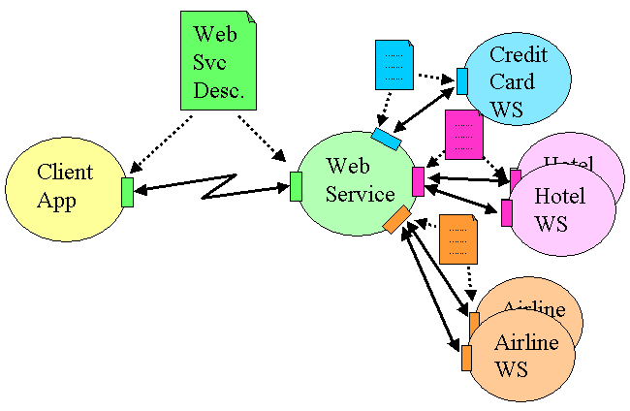

Slide 8
According to Microsoft, .NET is a “revolutionary new platform, built on open Internet protocols and standards, with tools and services that meld computing and communications in new ways.”
.NET is billed as a means for “connecting a world of information, people, systems and devices together to radically improve communication and business performance” regardless of the platform used.
A more practical way of explaining the concepts behind .NET would be:
It is a new environment for developing and running software applications
It provides the framework for an Internet-centric industry standard that makes it possible to tie together applications, information and data sources using Web Services
It enables software to become platform and device-independent.

Slide 9
Origin of .NET Technology
OLE TECHNOLOGY
Early 1990’s
COM TECHNOLOGY
Early 1995’s
Intermodule Communication
.NET TECHNOLOGY
Late 1990’s
Intersite communication
Interprocess Communication

Slide 10
Ole technology
Object Linking and Embedding (OLE) is a technology developed by Microsoft that allows embedding and linking to documents and other objects, to enable easy interprocess communication.
OLE is a compound document standard developed by Microsoft Corporation. It enables you to create objects with one application and then link or embed them in a second application. Embedded objects retain their original format and links to the application that created them.
An example of a compound document is a spreadsheet embedded in a Word for Windows document: as changes are made to the spreadsheet within Excel, they appear automatically inside the Word document.

Slide 11
Component Object model
The essence of COM is a language-neutral way of implementing objects that can be used in environments different from the one in which they were created, even across machine boundaries.
Microsoft introduced the component based model for developing software programs. In this approach ,a program is broken into a number of independent components where each one offers a particular service.
Each component can be developed and tested independently and then integrated it into main system.
Software built using such a technology is known as component ware.

Slide 12
Component object model
COM technology offers a number of benefits to developers and users. It:
Reduces the overall complexity of software
Enables distributed development across multiple organizations or departments
Enhances software maintainability

Slide 13
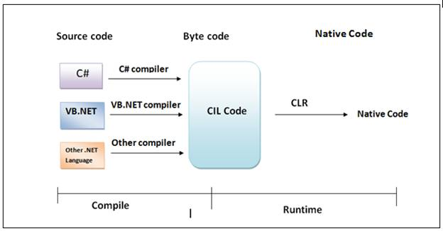
.net technology
It is 3rd generation component model.
.net provides MSIL (Microsoft Intermediate language) for intermodule communication.

Slide 14
Languages Supported by .NET
Out of the box, Microsoft currently provides support for the following languages:
Pascal
C
Smalltalk
Oberon
Scheme
Mercury
APL
Eiffel
Oz
Objective Caml
Microsoft Visual Basic.Net
Microsoft Visual C#
Microsoft Visual J#
Microsoft Jscript
Microsoft C++.Net
F#
Perl
Python
COBOL
Haskell
ML
Ada
Mondrian
Oberon etc

Slide 15
Platforms Supported
The .NET Runtime is compatible with Windows XP, Windows 2000 and Windows ME/98. Windows 95 is not supported.
It is important to note that some parts of the framework do not operate on all platforms. For instance, ASP.NET is only supported on Windows XP and Windows 2000.
In addition, Windows ME/98 cannot be used for development purposes .

Slide 16
Microsoft Visual Studio .NET
Microsoft Visual Studio is an integrated development environment (IDE) from Microsoft. It is used to develop computer programs for Microsoft Windows superfamily of operating systems, as well as web sites, web applications and web services.
Microsoft Visual Studio .NET includes support for all the Microsoft languages such as C#, C++, and VB .NET, with extensive wizard support.
It constitutes the core of .NET development. It provides a complete development platform to design, develop, debug and deploy .NET applications and Web Services.
It comprises tools for building Web and Windows applications as well as Web Services and also has a full set of data access tools.

Slide 17
There are also complete error -handling features available for local debugging, remote debugging and tracing.
Visual Studio .NET is available in Standard, Professional, Enterprise Developer and Enterprise Architect versions.
Latest stable release is MS Visual Studio 2015 RTM(Release to manufacturing)
It is available in Chinese, English, French, Portuguese, German, Italian, Japanese, Korean, Spanish and Russian language.
It is a proprietary software.
It is written in C++ and C#.
Website http://www.visualstudio.com/
Online help http://msdn.microsoft.com/

Slide 18
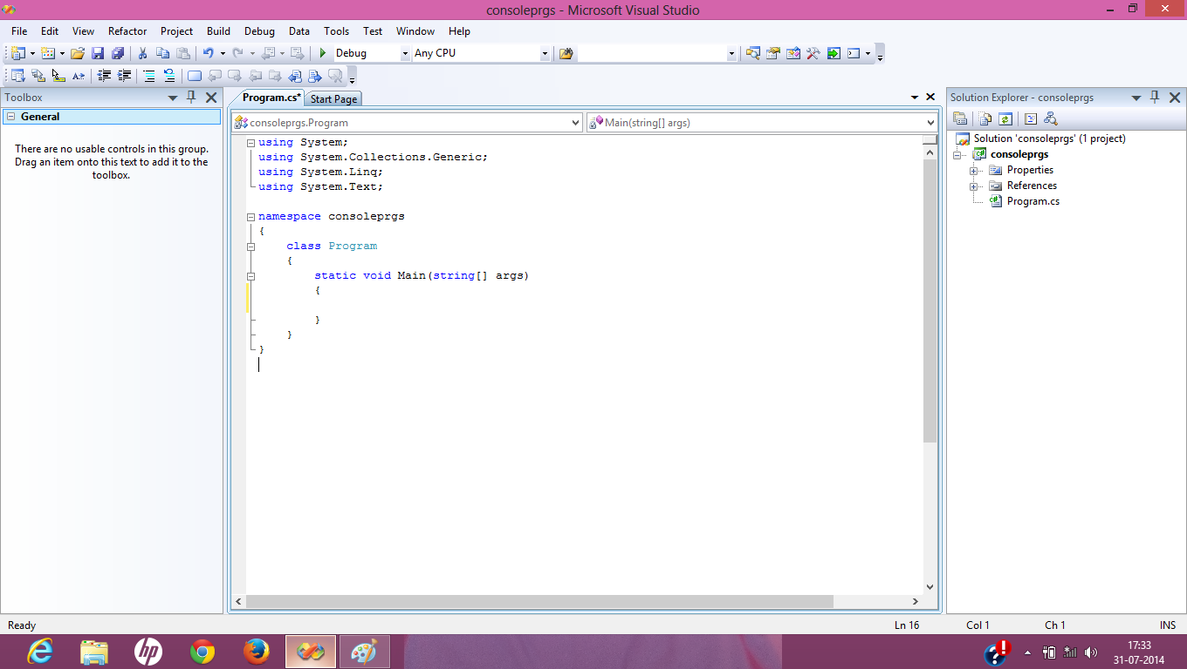

Slide 19
References
Programming in C# by Balagurusamy 3rd Edition.
www.visualstudio.com
Horizons-dotNET.pdf - ViewPoints.NET Technology By Aruna Paramasivam

